Slide 1
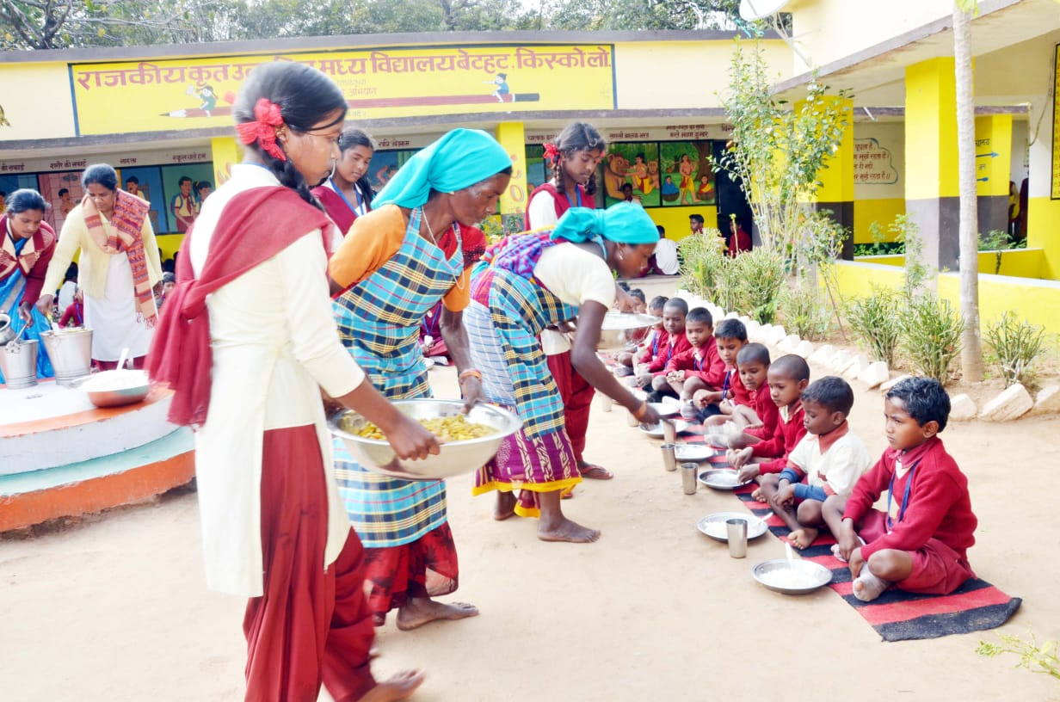
PAB - MDM Meeting for Review of Implementation of MDMS in Jharkhand on 29-04-2020
Mid Day Meal Scheme

Slide 2
Best Practices
i) Conducted Social Audit in 4856 schools in all 24 districts through Social Audit Unit Jharkhand during 2019-20.
Additional contribution of Rs. 500/-pm to honorarium of cook-cum-helpers from State’s own resources.
Distribution of 200 ml Milk per child per day in convergences with NDDB (National Dairy Development Board) in 4 districts viz. Ranchi (17 schools), Bokaro (7 Schools), Latehar (36 schools) and Hazaribagh(7 Schools) covering one lakh children.
One Egg per child twice a week (Monday and Friday) has been provided through State’s own resources.
Ministry of HRD, Govt. of India

Slide 3
Best Practices
v) Provision of additional Rs. 276.40 Lakh under MME from State’s own resources for strengthening district and block MDM Cell.
Active participation by Bal Sansad in each school during serving of MDM.
Ministry of HRD, Govt. of India

Slide 4
Issues
Less coverage of the children against the enrolment both in primary (66%) and upper primary (63%).
Slow progress in construction of kitchen-cum-stores against sanctioned during 2009-10 and 2011-12.
Less coverage under Health components specially distribution of Iron and Folic Acid and De-worming tablets.
Ministry of HRD, Govt. of India

Slide 5
Coverage of Children (Primary & U. Primary)
Children (Primary) |  |  |  | Children (Upper Primary)
State | PAB Approval | Coverage | %age | PAB Approval | Coverage | %age
Jharkhand | 2298182 | 1841662 | 80% | 997048 | 872861 | 88%
Ministry of HRD, Govt. of India

Slide 6
Working Days (Primary & U. Primary)
State | Working Days (Pry) |  |  | Working Days (U.Pry)
 | PAB Approval | Coverage | % | PAB Approval | Coverage | %
Jharkhand | 184 | 178 | 97 | 184 | 178 | 97
Ministry of HRD, Govt. of India

Slide 7
Engagement of Cook-cum-Helpers (Primary & U. Primary)
State | PAB Approval | Coverage | %age
Jharkhand | 79591 | 79,591 | 100%
Ministry of HRD, Govt. of India

Slide 8
Procurement of Kitchen Devices (Primary & U. Primary)
Kitchen Devices | Sanctioned | Procured | %age
New Kitchen Devices | 37132 | *37124 | 99.98%
Replacement of Kitchen devices | 15849 | 15849 | 100%
* 8 Kitchen devices not procured sanctioned during 2009-10
Ministry of HRD, Govt. of India

Slide 9
Construction of Kitchen-cum-Stores (Primary & U. Primary)
State | Sanctioned | Constructed | %age
Jharkhand | 39001 | 32523 | 83%
Ministry of HRD, Govt. of India

Slide 10
Setting up of School Nutrition Gardens (SNG)
No. of Schools | No. of schools having SNG | %
35773 | 2991 | 8%
Ministry of HRD, Govt. of India

Slide 11
Health Component - Performance
Details | Institutions | Children
Total in State | 35773 | 4180954
Health check up | 32617 | 3458088
IFA Distribution | 24715 | 1897336
Deworming Tablets | 25566 | 2633484
Ministry of HRD, Govt. of India

Slide 12
Testing of food samples
MHRD issued guidelines to ensure quality, safety and hygiene under MDMS in 2015
Testing of meals by NABL accredited laboratories.
Mandatory tasting of the meal by 2-3 adults including at least one teacher.
MDM Rules 2015 mandates collection of samples once a month from randomly selected schools or centralized kitchens for testing.
Testing may also be done through FSSAI accredited laboratories.
No. of samples |  | Result (No. of samples)
Collected | Tested | Meeting norms | Below norms
210 | 210 | 38 | 22
Only 60 reports have been received.
150 Reports are still awaited.

Slide 13
Status of implementation of MIS & AMS

Slide 14
Performance Grading Index (PGI)
Performance Grading Index (PGI):
Score against the weightage of 10 for indicator No. 1.3.7 i.e. “% of elementary school’s children taking MDM against target approved in PAB – in Govt. and aided schools”.
Score against the weightage of 10 for indicator No 1.3.8 i.e. “% of days Mid Day Meal served against total working days – Govt. and aided elementary schools.”
Score (children taking MDM) | Score (MDM served days)
8 | 10
Ministry of HRD, Govt. of India

Slide 15
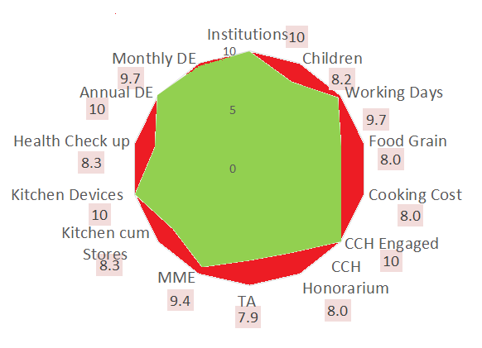
Performance Score Card
Component | PAB-Approval | Achievement | % Achievement
Institutions | 35773 | 35773 | 100%
Children | 3295230 | 2714523 | 82%
Working Days | 184 | 178 | 97%
Food Grain Utilizations (in MTs) | 69862.36 | 56125 | 80%
Cooking Cost (Rs. in Lacs) | 31279.9 | 25128.41 | 80%
CCH Engaged | 79591 | 79591 | 100%
CCH Honorarium (Rs. in Lacs) | 11938.65 | 9550.92 | 80%
TA (Rs. in Lacs) | 820.88 | 646.771 | 79%
MME (Rs. in Lacs) | 937.70 | 877.81 | 94%
Kitchen cum Stores | 39001 | 32523 | 83%
Kitchen Devices | 37132 | 37124 | 100%
Health Check up of children | 4180954 | 3458088 | 83%
Annual Data Entry | 35773 | 35741 | 100%
Monthly Data Entry | 35773 | 34800 | 97%
Ministry of HRD, Govt. of India

Slide 16
Social Audit
Social Audit is collective monitoring of a scheme by people’s active involvement.
It covers the issues of equity and equality along with expenditure in programme implementation.
The Social Audit Units (SAU) under MNREGS, may be actively involved in conducting Social Audit of MDM in all districts.
Key Features and Benefits:
It informs and educates people about their rights and entitlements.
It provides a collective platform for people to ask queries, express their needs and grievances.
It promotes people's participation in all stages of implementation of programme.
It brings about transparency and accountability in Govt. schemes.
It strengthens decentralised governance.
State has conducted Social Audit in all 24 districts.

Slide 17
Proposals and Recommendations
S. N | Component | PAB Approval 2019-20 | State’s Proposal for 2020-21 | Recommendations 2020-21
1 | Children (Pry) | 2294782 | 2294717 | 1894264
2 | Children (U Pry) | 997048 | 997048 | 891317
3 | Children (NCLP) | 3400 | 3465 | 3465
4 | Working Days – Pry & Upy | 254 | 253 | 253
5 | Working Days - NCLP | 312 | 310 | 310
6 | Cook-cum-Helpers (Pry +U.Pry) | 79591 | 79591 | 79591
7 | MDM during Drought
7.1 | Children (Pry) | 1701348 | Nil | Nil
7.2 | Children (U Pry) | 744254 | Nil | Nil
7.3 | Working Days | 25 | Nil | Nil
7.4 | Cook-cum-Helpers | 60496 | Nil | Nil
8 | Kitchen cum Store | Nil | Nil | Nil
9 | Kitchen cum Stores (Repair) | 12114 | 12114 | 12114
10 | Kitchen Devices (New) | Nil | Nil | Nil
11 | Kitchen Devices (Rep.) | 30497 | 30497 | 30497
Central Assistance (Rs in Lakh) |  | 42272.73 | 39159.20 | 37097.86

Slide 18
Recommendations of Central Assistance
(Rs. in Lakhs)
PAB Approval for FY 2019-20 | State’s Proposal for FY 2020-21 | Recommendations for FY - 2020-21
42272.73 | 39159.20 | 37097.86
Ministry of HRD, Govt. of India

Slide 19
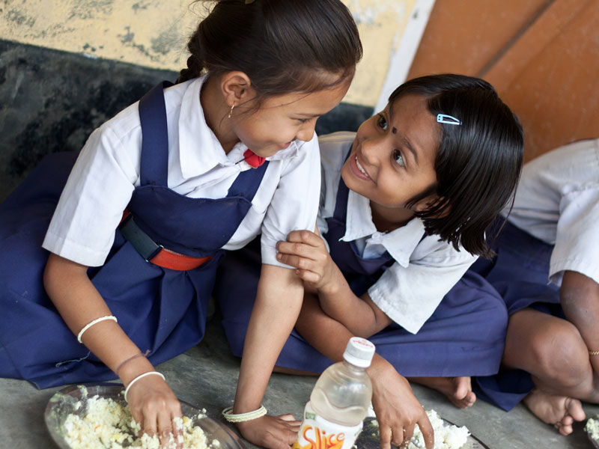
Every Meal to a Child is an offering to the Divinity.
Thank You

